Slide 1
Using the picozero Library
Install it using the Thonny Package Manager

Slide 2
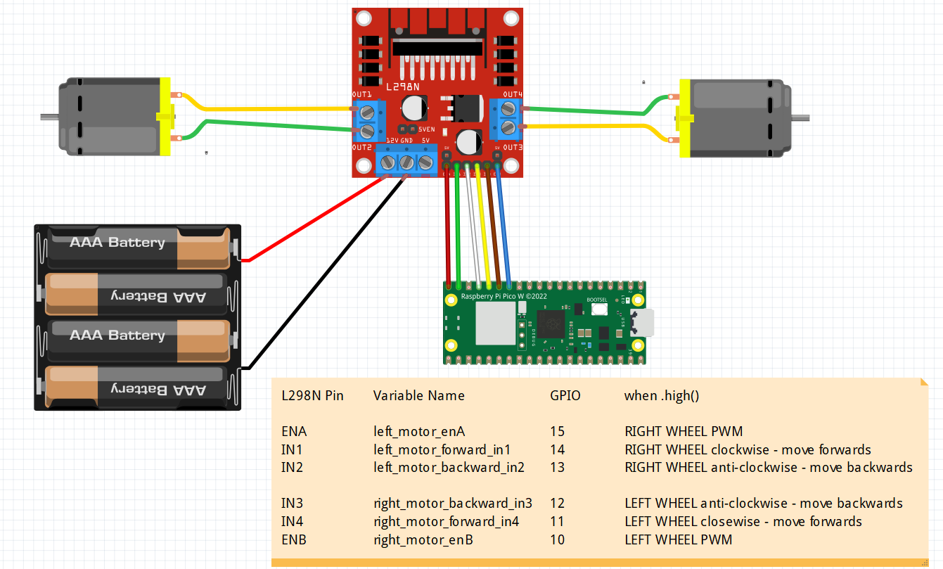

PINS ON THE LN298
Left Motor Forward
Right Motor Forward
Left Motor Backward
Right Motor Backward
on
LEFT
RIGHT

Slide 3
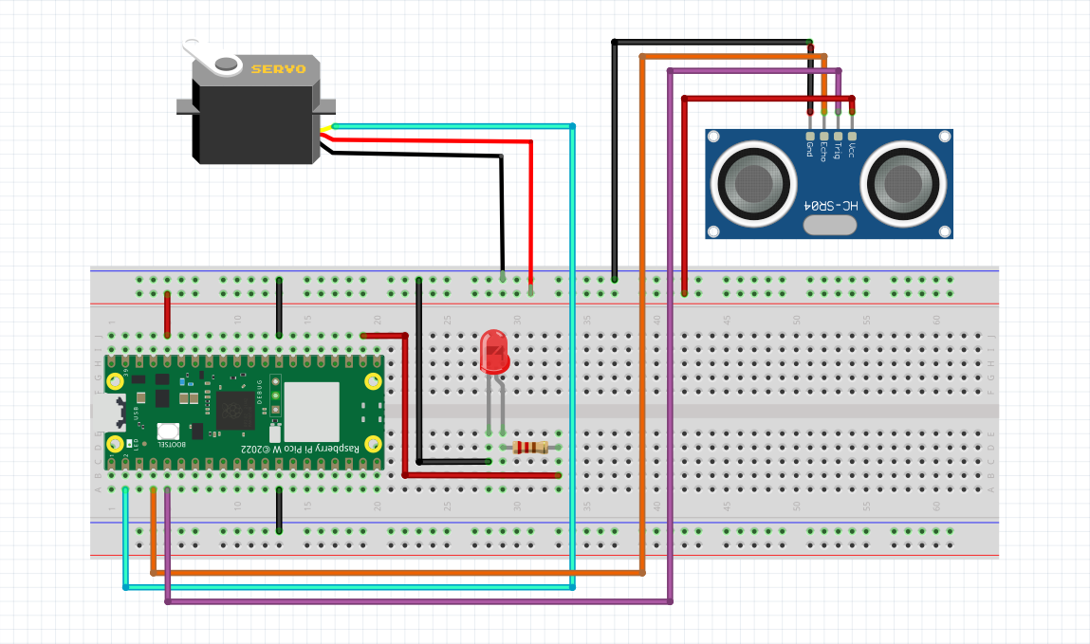
To be added to previous robot to form an autonomous robot
VCC can be connected
To VBU (5V) as well
VBU
VCC to be connected
To VBU (5V)

